Slide 1
EmployAble WebApp

Slide 2

Log In
Forgot Password
Username:
Password:

Slide 3

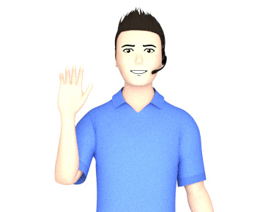



About Me
Resumé
Cover Letter
Learning
Jobs
My Docs
Hi Billy, welcome back! Please select from the options above to either change or update your details, update your CV or cover letter, or to track your learning and jobs that you are interested in. Alternatively, if you would like to have a chat about anything that is on your mind, please fire away in the box below.
What would you like to say?

Slide 4


About Me
Resumé
Cover Letter
Learning
Jobs
My Docs
My Personal details
My Skills
My Interests
Billy Smith
Aspiring Artist
Learn More About Me

Slide 5
About Me
Resumé
Cover Letter
Learning
Jobs
My Docs
My Personal details
This information isn’t public and includes things like my interests, aspirations, limitations as well as personal data Information here will not be seen by potential employers but will be used to help configure this app, show

Slide 6


About Me
Resumé
Cover Letter
Learning
Jobs
My Docs
Re-generate
Amend
Download to File
CV – Billy Smith
About me
I am an aspiring artist.........

Slide 7

About Me
Resumé
Cover Letter
Learning
Jobs
My Docs
For Position:
Art Teacher – South Melbourne Community Center
Re-generate
Amend
Download to File
Dear Sir/Madam,
I am writing to you to apply for the advertised position of 'Art Teacher' at South Melbourne Community Center.........

Slide 8
About Me
Resumé
Cover Letter
Learning
Jobs
My Docs
Add Course:
Ceramics for Beginners
Course Name | Provider | Link | Completed?
Teaching Visual Art | Queensland University via edx | Edx.com/qu-vis-art | Y
Advanced Oil Painting | VCA via Coursera | Coursera.com/vca-oil-paint

Slide 9
About Me
Resumé
Cover Letter
Learning
Jobs
My Docs
Add Position:
Director of Art at Port Phillip City Council
Position (see description) | Company | Suitability (see comparison) | Closing Date
Art Teacher | South Melbourne Community Center | Medium | 14/11/2023
Graphic Designer | Nike | Low | Closed
Bricklayer | Metricon Homes | Not Suitable | Closed
Illustrator | Penguin Books | High | Closed

Slide 10
About Me
Resumé
Cover Letter
Learning
Jobs
My Docs
Registration of Client
Job Plans
Placement confirmation
Industry awards
Client Registration
Emergency Forms
Medical Verification

